Slide 1

Human Body Size Estimation
Vidya Vikas Education Trust’s
Universal College of Engineering, Kaman Road, Vasai-401212
Accredited with B+ grade in the cycle I of accreditation by NAAC
Department of Computer Science
Team Members:
Shriyash Karekar (42)
Aqueel Alam Khan (45)
Imran Ali Khan (46)
Project GUIDE : Mr. Ashraf Siddique

Slide 2
Problem Statement
Nowadays online shopping are in a great boom, but when it comes to buying, we are often in doubt about our cloth size.
Most of the brands have their different standards for Clothing sizes.
Even if you want to know the our body measurements we need to visit to the tailor.
So with the help Human Body Size Estimator, we will try to overcome these problems using just our cell phones.

Slide 3

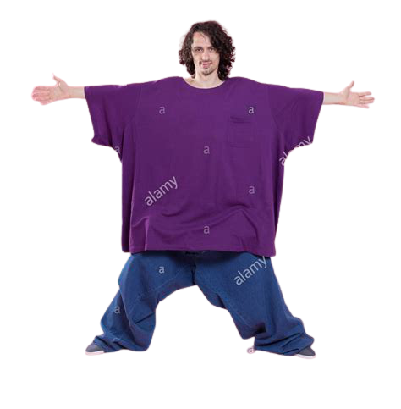


Traditional Approach
+
=
Ended up getting wrong size
Confused about size
Surfing on Internet

Slide 4
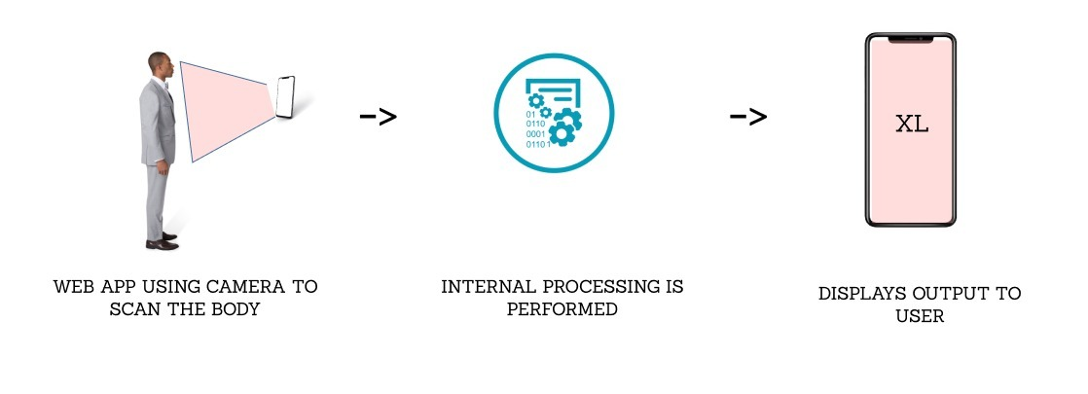
By using Body Size Estimator

Slide 5
Research Gap
Previous Approach:
By 2D processing – Time consuming, increases processing power and not feasible in some situations.
By 3D processing – Use of expensive tools like Range cameras and high-end scanners which is not feasible for common people’s to use.
Our Approach:
Combination of both previous approaches to get an optimized output.

Slide 6
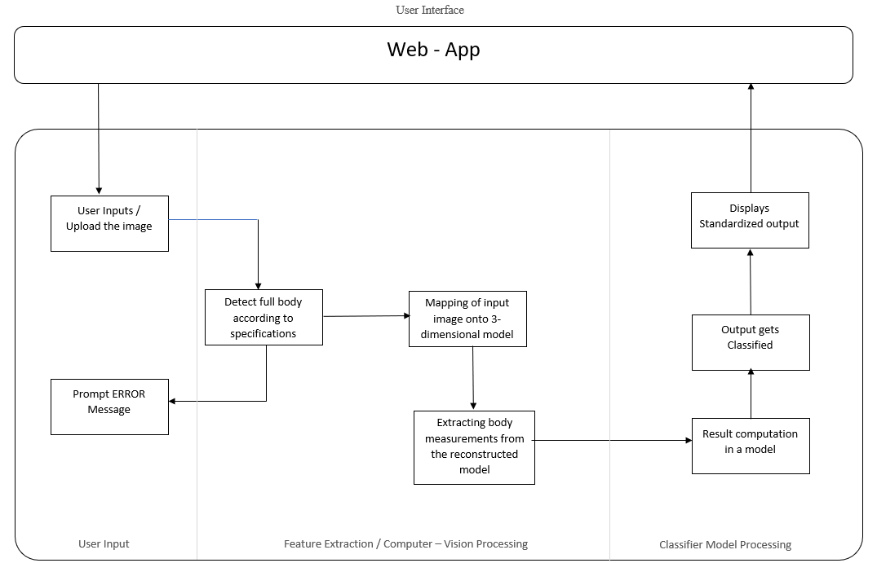
Architecture

Slide 7
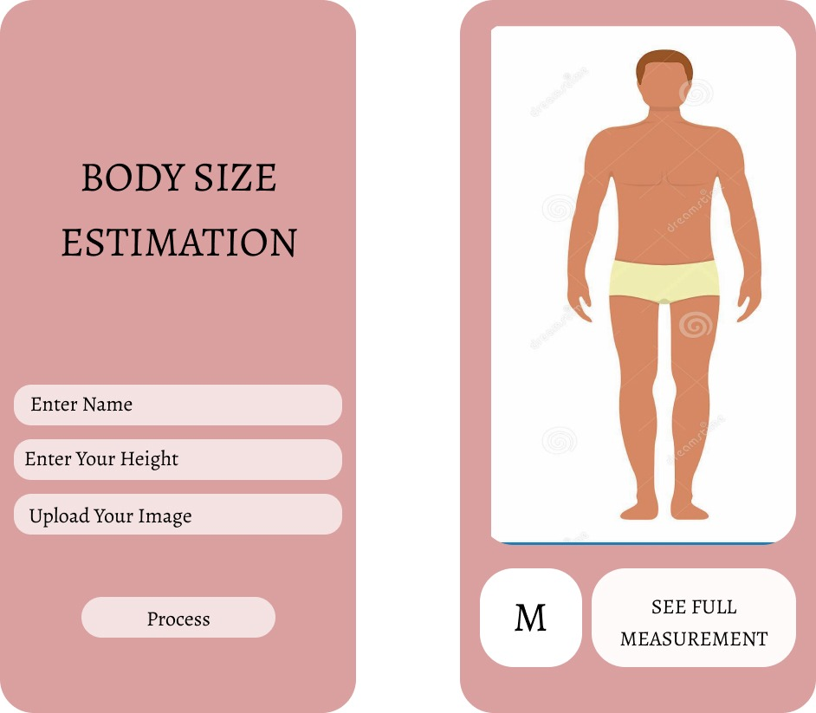
UI Prototype

Slide 8
Methodology
Key factors for implementation of project:
We are implementing this project in the Django so as that the webapp can be used across different platform and so the webapp will be platform independent.
After that user will be prompted to grant camera access followed by a prompt to enter the height.
Uploaded/Captured images should satisfy the conditions provided.
Project modules:
User input
Extraction of measurements from input’s
Classifier Model

Slide 9
Workflow of project
Obtaining User input through camera module.
Mapping of input image onto 3-dimensional model using 3D human reconstruction.
Encoding to 3D mesh using SMPL.
Extracting body measurements from the reconstructed model.
Obtaining measurements from 3D mesh.
Classification of measurements based on size chart.
Classifying obtained measurements into S, M, L, etc. using SVM model.

Slide 10
Model and Data sets
For Human body reconstruction and pose detection we will be using a pretrained model from researcher Angjoo Kanazawa - Kanazawa AI Research (KAIR) Lab.
Different human body measurements will be used to train Classification model (Support Vector Machine) which outputs size as per cloth measurement standards.

Slide 11
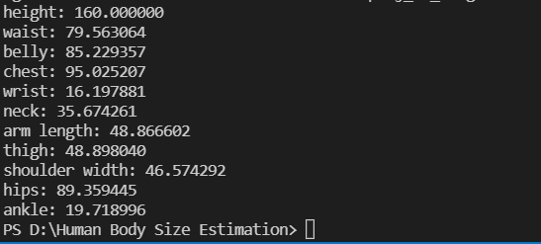
Implementation

Slide 12
References
[1] SEEING THROUGH THE APPEARANCE: BODY SHAPE ESTIMATION USING MULTI-VIEW CLOTHINGIMAGES Wei-Yi Chang and Yu-Chiang Frank Wang Research Center for Information Technology Innovation, Academia Sinica, Taipei, Taiwan
[2] 16th International Learning & Technology Conference 2019 FITME: BODY MEASUREMENT ESTIMATIONS USING MACHINE LEARNING METHOD
[3] BodyPix: Real-time Person Segmentation in the Browser with TensorFlow.js
[4] Real-time Clothing size body measurement estimator using Ten
[5] E. Young Kim, Y.K. Kim, Predicting online purchase intentions for clothing products, Eur. J. Market. 38 (2004) 883–897.
[6] H.K. Song, S.P. Ashdown, Investigation of the validity of 3-D virtual fitting for pants, Cloth. Textiles Res. J. 33 (2015) 314–330.
[7] J. Kim, S. Forsythe, Adoption of virtual try-on technology for online apparel shopping, J. Interact. Mark. 22 (2008) 45–59.
[8] A.S.M. Sayem, R. Kennon, N. Clarke, 3D CAD systems for the clothing industry, Intl. J. Fashion Des. Tech. Educ. 3 (2010) 45–53
[9] Angjoo Kanazawa, Michael J. Black, David W. Jacobs, Jitendra Malik, End-to-end Recovery of Human Shape and Pose, 18 Dec 2017

Slide 13
Thank You!!

